Slide 1
NAFTA and Its Effects
Alan V. Deardorff
University of Michigan
For presentation at the Conference
The Many Automotive Truths of NAFTA
Sponsored by UMTRI
April 12, 2017

Slide 2
NAFTA
“The single worst trade deal
ever approved in this country”
- Donald J. Trump, candidate

Slide 3
I’ll look at
Trade after NAFTA
Economic analyses of NAFTA
Renegotiating NAFTA

Slide 4
Growth of Trade after NAFTA
US-NAFTA trade doubled 1993-2000
World trade grew much less
US-NAFTA trade grew more slowly after 2000
World trade took off after 2001 (China’s entry to WTO)

Slide 5
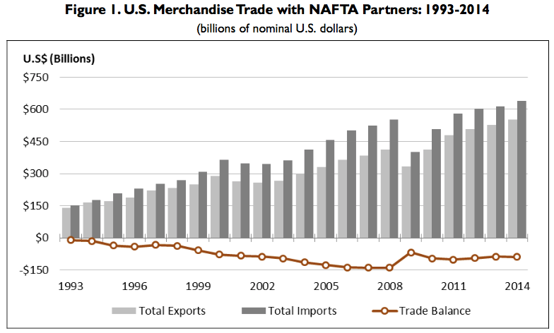
Source: Congressional Research Service (2015)

Slide 6
Source: WTO data

Slide 7
US Trade Deficit after NAFTA
Deficit with NAFTA partners grew
  From about zero in 1993
  To $150 billion in 2008
Most of that was petroleum
Non-petroleum deficit is now back to about zero

Slide 8
Source: Congressional Research Service (2015)

Slide 9
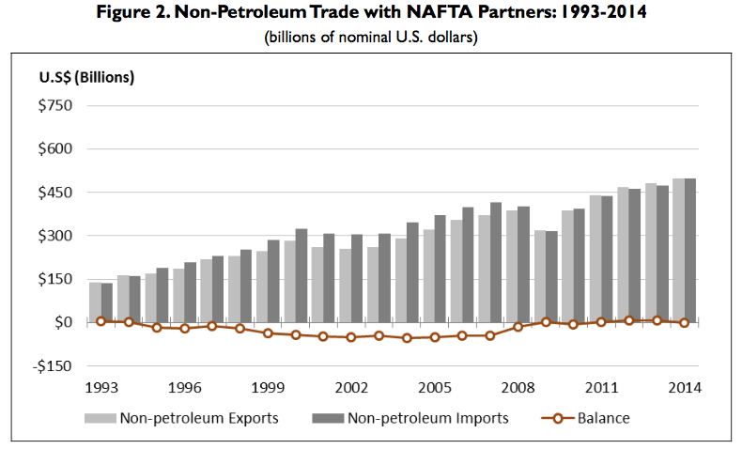
Source: Congressional Research Service (2015)

Slide 10
Components of US-NAFTA Trade
Largest imports are petroleum
Largest exports are motor vehicle parts (also a major import)
Motor vehicles are major import and (though smaller) export

Slide 11
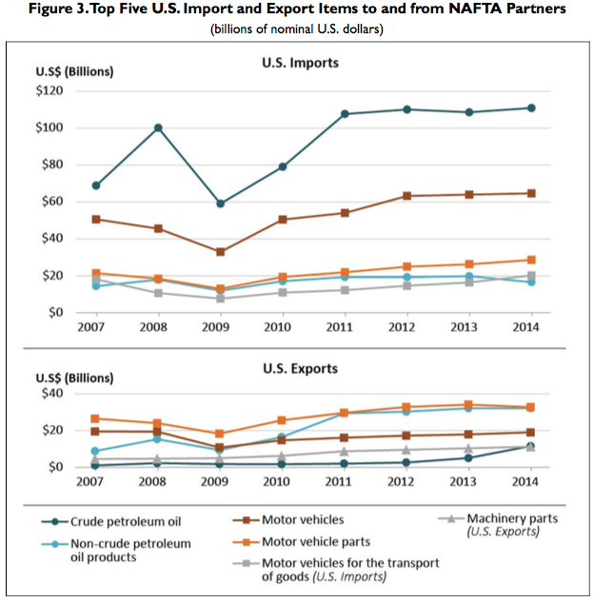
Source: Congressional Research Service (2015)

Slide 12
Effects of NAFTA
Analyses: Before
  Many studies examined likely effects
  Some, from both sides of the debate, used spurious analysis to support their views
    Example: All imports from Mexico are viewed as costing jobs
    On the positive side, advocates of NAFTA did the same with US exports, presumed to rise a lot because of Mexico’s high tariffs

Slide 13
Effects of NAFTA
Analyses: Before
  Best academic studies (including our “Michigan Model”) predicted
    Positive, but very small, benefit to the US
    Negligible disruption of US labor markets
    Positive, somewhat larger, benefit to Mexico
    Significant disruption in some Mexican markets
  Nobody predicted Peso Crisis

Slide 14
Effects of NAFTA
Analyses: Before
Reasons for small predicted effects on US
  US MFN tariffs were already very low
  Much trade with Mexico was already at even lower tariffs, under Maquiladora system
  US trade with Mexico was big, but not all that big, compared to size of US economy

Slide 15
Effects of NAFTA
Analyses: Before
The Main Issue that Raised Concern
  Mexican wages were only about 1/10 of US wages
  Seemed obvious to many (e.g., Ross Perot) that employers would move to Mexico
Answer
  Mexican wages were low for a reason: low productivity
  If this had not been true, jobs would already have moved, given our already low tariffs

Slide 16
Effects of NAFTA
Analyses: After
Romalis (2005)
  Welfare effects close to zero for US, Canada, and Mexico
Caliendo and Parro (2015)
  Updated earlier studies with more recent analytical tools
  Found
    Welfare benefits for US and Mexico, but
    Welfare loss for Canada

Slide 17
Welfare effects from NAFTA’s tariff reductions
 | Welfare
Country | Total | Terms of Trade | Volume of Trade | Real Wages
Mexico | 1.31% | –0.41% | 1.72% | 1.72%
Canada | –0.06% | –0.11% | 0.04% | 0.32%
U.S. | 0.08% | 0.04% | 0.04% | 0.11%
Source: Caliendo and Parro (2015), Table 2

Slide 18
Effects of NAFTA
Analyses: After
Posen (2014)
  “For every 100 jobs US manufacturers created in Mexican manufacturing, they added nearly 250 jobs at their larger US home operations”
  Unemployment in US was actually lower after NAFTA than before (until the 2008 financial crisis)
  Critics say NAFTA cost 45,000 jobs a year.
    That may be true
    But this is only 0.1% of normal job turnover in the US, where 4m-6m workers leave or lose jobs per month)

Slide 19
Effects of NAFTA
Analyses: After
Hakobyan and McLaren (2016)
  They look for effects on local labor markets, where
      industries
      and/or communities
    were vulnerable to large tariff cuts against Mexico
  They find
    Substantial variation across localities

Slide 20
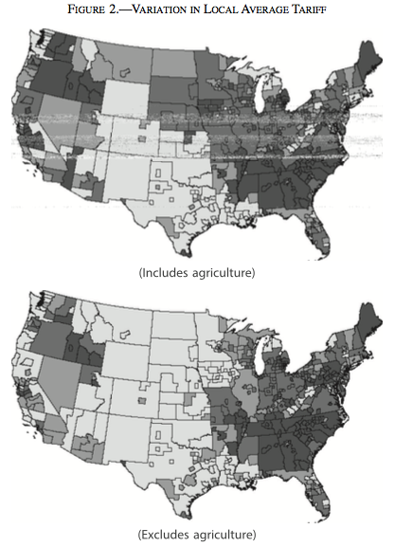
Source: Hakobyan and McLaren (2016)

Slide 21
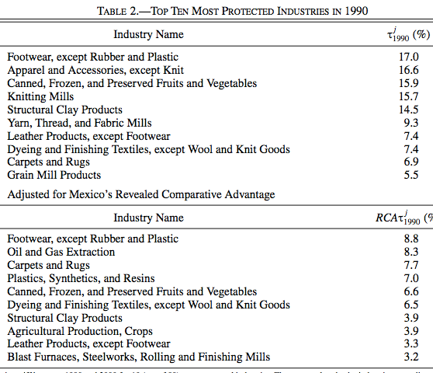
Source: Hakobyan and McLaren (2016)

Slide 22
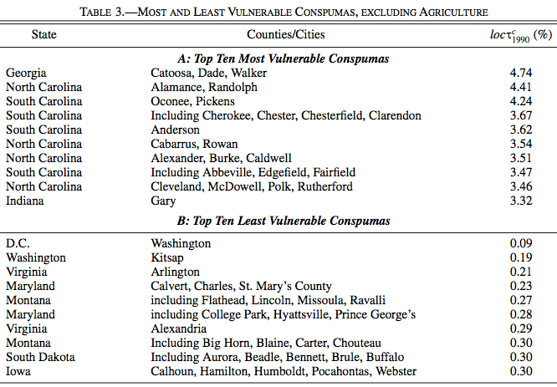
(Consistent Public-Use Microdata Areas)
Source: Hakobyan and McLaren (2016)

Slide 23
Effects of NAFTA
Analyses: After
Hakobyan and McLaren (2016)
  “The fact that both the location and the industry effects hit blue-collar workers, especially high school dropouts, but not college graduates suggests the possibility that the costs of moving or of switching industries are larger for less educated workers, so that more educated workers can adjust more easily and arbitrage wage differences away.”

Slide 24
Effects of NAFTA
Analyses: After
Hakobyan and McLaren (2016)
  “…even workers in a nontraded industry—waiting on tables in a diner, for example—saw a sharp reduction in wages if they were in a vulnerable location that lost its protection quickly.”

Slide 25
Effects of NAFTA
Analyses: After
Disruption of some industries and localities
  Was expected
  May have been larger than expected
  Has not been dealt with adequately by TAA
  Nonetheless was still small
  But provides easy ammunition for critics

Slide 26
Renegotiating NAFTA
Donald Trump said he would either
  Pull out of NAFTA, or
  Renegotiate NAFTA

Slide 27

Renegotiating NAFTA
Nov 21, 2016:
Feb 1, 2017:
Mar 30, 2017:

Slide 28
Renegotiating NAFTA
The “modest changes”:
  “Snapback tariffs”
  Changes in Rules of Origin
  Permit “Buy American” in government procurement
  Several features that were part of TPP
    Protection of digital trade
    Tougher intellectual property enforcement
    Requirements on state-owned enterprises
    Labor and environment provisions
  Does not mention currencies

Slide 29

Renegotiating NAFTA
April 11, 2017:
In a meeting with company executives Tuesday morning, Trump promised more progress on the talks. "We’re going to have some very pleasant surprises for you on NAFTA," he said.

